Slide 1

AWS DATA LAKE
Thornquist
Outfitters
Store sales, ecommerce orders and customer records
in one validated reporting dataset
Mahbub Alahi, Justin Mebodo and Seyi Akinnirun
Midterm Demonstration
23 October 2026

Slide 2
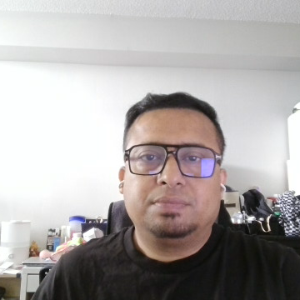
Project
architecture
Three ingestion paths
Four S3 zones
Quality checks and quarantine
Curated Parquet and Athena
Open the full
architecture PDF
02

Slide 3

Ingestion and data quality
Three ingestion methods
Verified source reconciliation
POS CSV
Source | Read | Pass | Reject
POS | 1,051 | 1,048 | 3
Orders | 265 | 226 | 39
Customers | 400 | 400 | 0
Scripted copy into Raw
Ecommerce JSON
S3 upload invokes Lambda
Customer CSV
Glue job with daily 07:00 UTC trigger
Glue rejects quantity -1 to quarantine
Corrected order produces 4 sales lines
Schema fixes: customer IDs, dates,
nested items and numeric types
7 custom checks cover required fields, duplicates, dates, customer references,
quantities/prices, item structure and order totals
03

Slide 4

Athena analytics and governance
320,570.35 total accepted sales
1,601 sales lines for 24–30 August 2026. Amounts use source units.
Curated performance
Snappy Parquet
Year and month partitions
Deployed controls
HTTPS bucket policy
Glue failure and alarm
email tests passed
Analyst IAM and Lake Formation:
documented permission design
6 SQL queries answer 5 questions. Exported results feed the HTML charts.

Slide 5
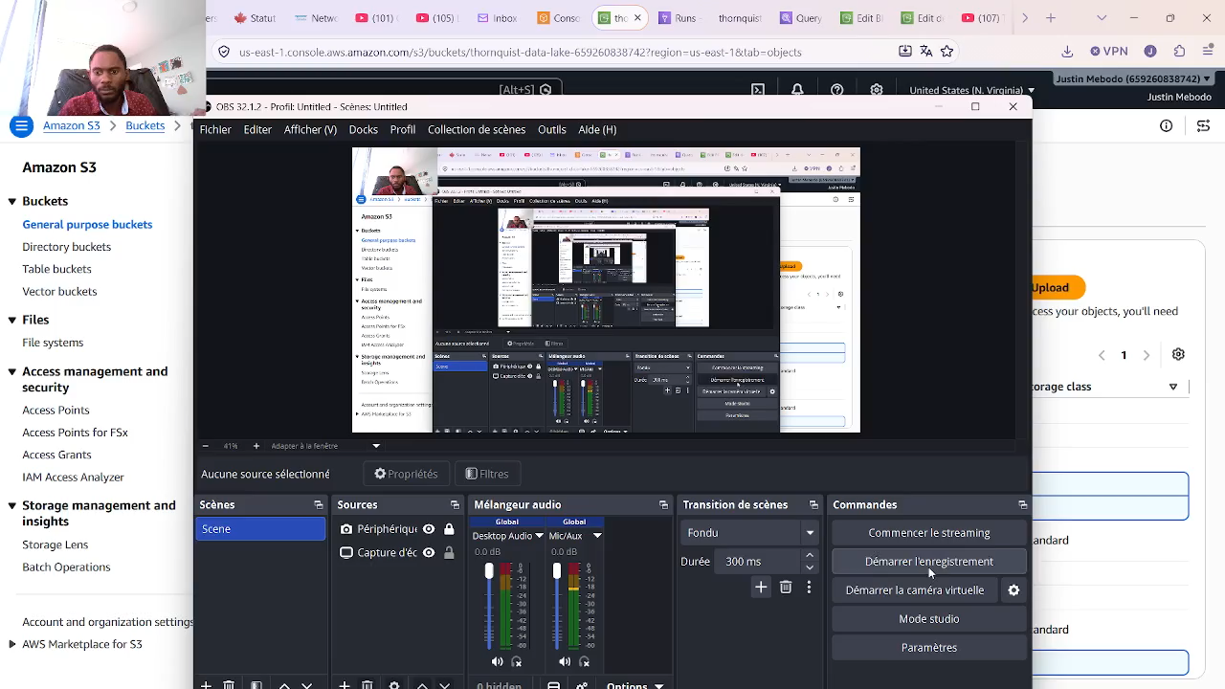

Slide 6
Results and evidence
Demonstrated
Configured and documented
Full pipeline rehearsal passed
Raw and Trusted Athena queries
Automated rejection and correction
Curated Parquet and six business queries
Glue failure and alarm email tests
Customer and crawler schedules
Analyst IAM and Lake Formation designs
Proposed cross-zone bucket policy
Project repository
Questions

